Slide 1

STRATEGIES FOR ENDING CHILD MARRIAGE IN THE HORN OF AFRICA
Martha Tukahirwa
SIHA NETWORK

Slide 2
About SIHA Network
The Strategic Initiative for Women in the Horn of Africa (SIHA) is a network of civil society organizations from Sudan, South Sudan, Somalia, Somaliland, Ethiopia, Eritrea, Djibouti, Uganda, and, most recently, the coastal area of Kenya.
Established in 1995 by a coalition of women’s rights activists with the aim of strengthening the capacities of women’s rights organizations and addressing women’s subordination and violence against women and girls in the Horn of Africa, SIHA has grown substantially and is now comprised of close to 75 member organizations.

Slide 3
SIHA’s Vision
“All women and girls in the Horn of Africa have the right to live in a peaceful, just environment and that they are able to exercise their equal rights as human beings.”
Notes:
Strategic themes:
Challenging violence against women and girls especially in sexual exploitation in conflict & post-conflict situations.
Combating trafficking of women and girls in the Horn;
Strengthening women’s access to justice
Transforming negative, harmful religious & cultural dogma
Building inclusive women’s movements as agents of Women human rights defenders (WHRD)
Empowering women economically towards the realization of Economic, Social and Cultural Rights (ESCR) in the informal sector

Slide 4
Drivers of child marriage in the Horn of Africa
Poverty and economic degradation: High levels of poverty, conflict, instability, low levels of literacy and gender gaps in education fuel child marriage in South Sudan. Girls and families often feel that they are escaping poverty by marrying young.
Many South Sudanese communities see child marriage as a way to protect girls from pre-marital sex and unwanted pregnancies. Families also marry off their daughters in exchange for a bride-price or other much-needed resources such as of cattle.
  In the case that the girl has higher education, then there is added value for bride price – thus the commodification of women;
South Sudan’s lack of a strong legal framework, along with poor enforcement of existing laws, means that perpetrators are rarely bought to justice.
Notes:
Prevalent forms of VAWG in the Horn of Africa (Common in Ethiopia, Sudan, Somalia and South Sudan) –
Falling through the cracks (customary law is still dominating / reference for relations)
Key statistic: 52% of girls in South Sudan are married before their 18th birthday
The commodification of the institution dowry is linked to the commodification of women who are considered as goods for exchange;
Dowry exchange is considered an important social function as a symbol of wealth and status: Community outreach needs to be conducted in the promotion of the notion that dowry is symbolic and not cash-oriented.
Responses to sexual violence against women and girls are determined in part by their bride wealth value. The rape of an older girl may be undeemed unworthy of compensation or pursuit of justice, compared to the rape of a younger girl – which is considered a greater “crime”

Slide 5
Drivers of child marriage in Somalia
Child marriage in Somalia is exacerbated by the absence of a coherent legal framework to which women can appeal for justice;
Under Somali customs, parents can choose their daughter’s husband and decide if their daughter will to undergo female genital mutilation. Forced marriages are not uncommon, and young girls are often given away as brides without their consent. Girls have also been commoditized as exchange for marriage between the warring tribes as part of a peace negotiations, or subject to “inherited” marriage, including practices where a man is entitled to “inherit” the widow of his deceased relative
Women and girls who have been raped are often forced to marry their rapists to uphold family honor, and rapists can avoid punishment if they marry their victim. A woman who refuses such a marriage may face severe consequences from her own family and clan.
Notes:
For #1: Deep cultural prejudices have continued to undermine men’s ability, efforts and willingness to become allies in anti-violence initiatives in curbing child marriages in the country;
For #3: Women in nomadic communities who resist forced marriages may be outcast from the community
#4: In Somalia’s patriarchal and clan-based society, men occupy positions of dominance and authority and are often positioned such that they can protect against, permit or perpetrate abuse. The lack of a formal legal framework combined with customary law, Shari’a law and statutory law ensures SGBV survivors do not have access to justice.

Slide 6
Drivers of child marriage in Sudan
Sudan is a country with limited space for women to exercise their civil, political and human rights.
In the case of Sudan, issues regarding the rights of women and girls are complex and highly politicized owing to Islamization of the state and Sharia laws which target and harm women and girls;
Sudan struggles with cycles and various pockets of conflicts across the country which leads to polarization – war in Darfur and Nuba Mountains

Slide 7
Child marriage in Nuba Mountains, Sudan
A hallmark of gender inequality:
Status of conflict on child marriage / De-prioritization of girls’ education: In Nuba Mountains, there are no schools / educational institutions because the infrastructure was destroyed in the war;
  Roles of girls and boys: Boys are trained to be soldiers while girls are brought up to be wives to soldiers (Women and girls have remained embedded in traditional roles, disempowered both in household and political spheres)
Religious laws in Sudan:
  Age 10: The Sudanese government has failed to amend the laws that allow girl child marriage, referring to the Sudan Personal Status Act of 1991 which contains an article allowing for the marriage of girls as young as 10.
Notes:
Based on SIHA’s experience (Gender and Bombardment) – under Sudan Consortium website because of the nature of our work in the country
Patriarchal social structures in addition to politics, conflict and religion have left women’s voices absent from exercising their rights and enjoying equality;

Slide 8
SIHA’S WORK IN THE REGION: Ethiopia and Eritrea
With the influx of Ethiopian migrant adolescent girls into the Gulf through Somalia in search of better economic conditions, many of these girls are deported back into Ethiopia – thus increasing their vulnerability as Internally Displaced People (IDPs), and being more susceptible to trafficking and child marriages. These girls account for nearly 50% of the migrant population.
In Ethiopia, Eritrea and Somaliland, SIHA works very closely with and through its members to advocate and provide direct support related to girls migrating seeking economic opportunities – through skills development programs;

Slide 9
Contexts and lessons learnt from men’s interventions in child marriage
Men in their roles as fathers places them as an important interface between the family/household, local community and the broader (social, cultural and political) society. This therefore is a stage for critical intervention and subsequent exploitation;
  The culture of silence can be broken when the support from men comes (in the case of daughters refusing marriage proposals at a young age)
In Somalia, campaigning against marriage can be conveyed by broadcasting of messages on radio, newspapers, text messaging and social media platforms (promoting the culture of peace, co-existence and respect for women and young girls)
Notes:
Men as Allies.

Slide 10
Strategies for ending child marriage in the Horn of Africa
(Community-driven solutions)
When we talk about strategies for ending child marriage, we must involve the rights holders (young women and girls), technical parties, duty-bearers (police and the judiciary), social actors (religious and cultural leaders)
Awareness intervention: Organization of large awareness campaigns to change the attitude of communities especially in the rural area. (Forums for parents, teachers and students in the communities – attended by health workers)
Creatively engaging with traditional authorities: The chiefs are principle actors in entrenching and conserving customary norms and values:

Slide 11
Strategies continued…
Enforcement of legal and policy frameworks that protect: Governments need to uphold the international treaties they signed and ensure the rights of children by enforcing laws (around early marriage, divorce, dowry, succession, inheritance etc) within their countries. Because existing national laws are often poorly enforced or superseded by customary and religious laws, it becomes particularly important to work with community leaders and members of the law enforcement and the justice sectors;
There need to be interventions to promote legal literacy and support paralegal services. Legal and other support services must also exist for those who want to escape child marriages and for those who are facing the prospect of early marriage (Working example of Noura’s case to follow)

Slide 12
Strategies continued…
Shifting norms around child marriage in the Horn: Programming efforts within the region need to be sensitive to the region’s cultural context in tackling complex economic issues and deeply rooted social norms, attitudes, and practices. Therefore, it is imperative that communities are engaged to find locally-appropriate strategies for ending child marriage.
  (Basic financial management for young women and girls in communities where child marriage prevails)
  Economic empowerment of young women and girls, for example – helping them better understand their economy to come up with sustainable income-generating activities)

Slide 13
Strategies continued…
Working with girls and parents of girls in these regions: Child marriage is most likely a consequence of economic constraints because of poverty, and society pressures – therefore attitudes of parents need to be transformed as immediate duty-bearers to identify sustainable alternatives for the survival and well-being of the entire family; (Community self-help saving groups)
Working with men: Interventions that engage men in the society, as well as religious and cultural leaders – who are most likely men too – must be employed to leverage the role of girls as change-makers and important contributors to the livelihood of the family;

Slide 14
Strategies continued…
Addressing the needs of the married children: Because of many of these girls are isolated from their communities and face severe stigma, it is important to make them aware of their rights especially in the area of SRHR and other opportunities that may be available to them;
  Family planning services
  Maternal and child health care
  Married adolescent peer educators serving as role models and community outreach volunteers;
  Providing training and support to health care providers and local health care facilities to ensure that quality youth-friendly services are available and accessible;

Slide 15
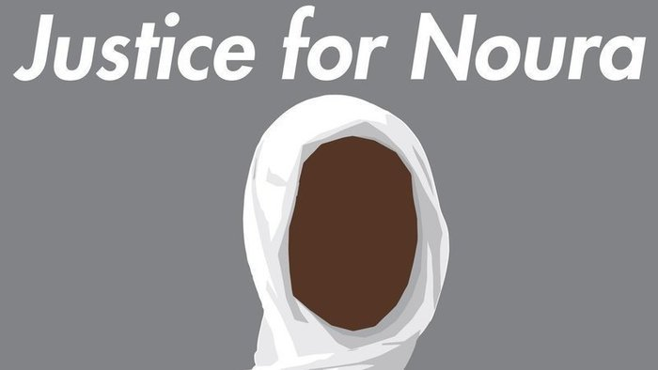

Slide 16
#JusticeForNoura: Introduction
Noura Hussein Hamad is a 19 year old, secondary school graduate – originally from Darfur however relocated to Al Bagir town, south of Khartoum;
At the age of 15 or 16, Noura ran away from her town to save herself from being forced into an arranged marriage to a man without her consent. After fleeing her home, Noura sought refuge at her aunt’s place in Sennar State and continued her education until she finished secondary school.
In early 2017, her family convinced her to come back saying that the man was no longer interested in marrying her. When she returned to her family in Al Bagir town she found that the family was holding the wedding ceremony against her will and without her own approval. Her family – at the time – signed the marital contract.

Slide 17
#JusticeforNoura: Continuation of Introduction
After completion of the wedding ceremony, the husband took Noura to an apartment in Omdurman city of greater Khartoum state, located in Al Mohandesin neighborhood, where he persistently demanded his “marital right” to have sex.
Noura resisted any sexual relations with the man for four days, after which on day five he brought about four male relatives into the furnished apartment. The men violently held Noura down to the bed while she was forcibly raped by the husband – all the relatives witnessed this act of rape. The incident took place in the last week of April 2017

Slide 18
#JusticeforNoura: Noura’s “Crime”
Noura was found guilty of pre-meditated murder under Article 130 of the Sudanese Criminal Act after she prevented her husband from raping her the second time by stabbing him with a knife, which led to his death from the injuries.
She was sentenced to death by hanging at the “Omdurman Wasat” Criminal Court, for defending herself against the man who brutally raped her.
As two months ago, Noura, through her lawyers filed an appeal through the Court of Appeal awaiting a decision in a couple of months;

Slide 19
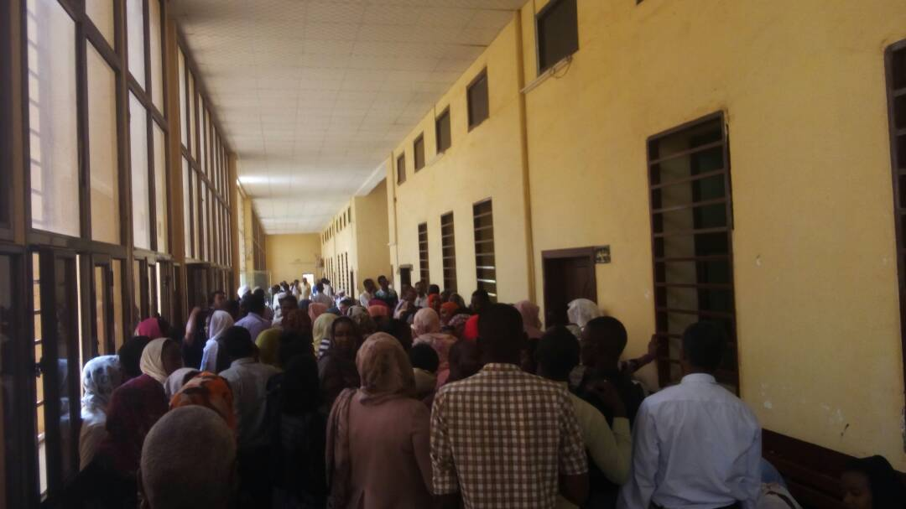

Slide 20
#JusticeforNoura: Trapped between Misogyny and Dogma
The concept of guardianship in Sudanese Personal status Law is one of the greatest restrictions to women’s ability to control their lives and make decisions independently. Under Article 33 of the Personal Status Law, the guardians are: adult men that are Muslim, of sound mind and they do, among other things, decide upon the suitability of a potential husband, meaning that a woman can effectively be married without her consent if her guardian approves.
Forced marriages and marriages to minors which are permitted by the Personal Status Law under Article 34, with permission of the girls’ guardians and with her consent.
Notes:
For #1: Another element in the law that enables Noura’s victimization is that a woman is not permitted to marry of her own preference, and if she does, her male guardian has the right to cancel the contract.
For #2: However, this is a clear contravention to the 1989 UN Convention on the Rights of the Child, which was ratified by Sudan in 1990, which forbids marriage under the age of 18 and must thus be addressed seriously. In Noura’s case she was initially about to be married off to the man at the age of 15 or 16, upon which she ran away to her aunt.

Slide 21
#JusticeforNoura: Next steps of action
An urgent need for Legal Reform in Sudan
  The Sudanese domestic legal framework is characterized by limitations in responding to human rights violations, and by discrimination and abuses mainly targeting women and girls;
  The Sudanese government has failed to amend the laws that allow girl child marriage, referring to the Sudan Personal Status Act of 1991 which contains an article allowing for the marriage of girls as young as 10.
The contemptible assumption:
  Girl child marriage is an appreciative matter in Islam and has many advantages including the prospect of being able to produce many offspring.
Notes:
Much-needed Response
The Sudanese government needs to conform the country’s personal laws to international obligations and to immediately ban and criminalize the granting of marriage licenses for girls under the age of 18;

Slide 22
#JusticeforNoura – Saved for now!
Noura is no longer being charged under Article 130 – capital punishment in the Sudan Criminal Act, where the appeal court has accepted the lawyers appeal.
She is now being charged for five years in jail for the self-defense crime and payment of three hundred and fifty thousand Sudanese Pounds as deia money to the family of the deceased – which is equivalent to ten to twelve thousand (US$ 12,000).
If the diya is not paid within the allocated time frame, then Noura will have to serve a longer time in prison. This sentence however might be contested by the family of the deceased.
Notes:
Noura is still being punished for being forcefully married and raped. No changes are expected to occur in Sudan’s personal status law imposing guardianship (wilayah) on women and girls’ decisions of marriage. Despite the fact that Sudan is a signatory to the Convention on the Rights of Children, the Sudan Personal Status Law allows girls to be married as of age 10 years.
The Sudanese Personal Status Law emerges as demeaning to the identity of women and girls presenting them as inferior, unable to survive, decide and manage their lives without oversight from men.

Slide 23
Key Advocacy Messages to implement in all programming
Ratification of continental and international mechanisms and instruments meant to protect the rights of children in the Horn of Africa;
Adoption of domestic laws and policies to give effect to the provisions of the charters and other continental instruments;
Harmonizing civil, customary and common law definitions of the child in line with all continental instruments;
Promotion of girls’ skills development and universal health care and facilities to ensure the safety of child in the Horn of Africa;
Notes:
Child marriage in Uganda – in Northern Uganda (ending bride price) – link to South Sudan to make such a decision;

Slide 24
Questions and Discussion

