Slide 1

Special Needs Housing
Presentation to CLC SNH Workshop 28 June 2012
by Mark Misselhorn - CEO
‘Working to change the lives of the poor through
appropriate and sustainable development’
28th June 2012
Notes:
Thanking for opportunity
Apologies for Mark
Presentation 3 parts - PPT overview, SNH background, Project proposal
Go quickly over the first 2 parts

Slide 2

PPT – Organisational Overview
Specialises in preparing a wide range of pro-poor development projects: informal settlements, low income housing, special needs housing, pro-poor LED, infrastructure, capacity building etc.
Independent, public interest & non profit – registered Trust, NPO & PBO.
Est. 1993 - 18-year proven track record
R1.61 billion leveraged for 107,423 hh on 177 projects
113 projects under preparation benefiting 135,356hh with R1.87billion capital value

Slide 3
PPT – SNH Programme Overview
Since 2002 – 10years
R44million leveraged for 35 projects benefiting 915 people in special need
18 Projects (R34 million) benefiting 581 beneficiaries currently under preparation
Mainly KZN, EC, Gauteng, WC
Use of revolving preparation funding
Significant SNH ‘manuals’, policy & advisory work
1st Comprehensive SNH ‘manual’ 2005. Currently being updated.
Funding recently secured from the DG Murray Trust for further work in W Cape and E Cape.

Slide 4
What is SNH? – an inclusive definition
Provision of improved shelter / accommodation utilising state housing subsidies for those in special need – i.e. who are:
OVC’s
affected by HIV AIDS
seriously ill
old and infirm
disabled
homeless / on the street
victims of domestic violence
under substance rehabilitation
etc.

Slide 5
What is SNH – how does it work?
Utilises the institutional subsidy mechanism – in KZN the transitional sub-type
A suitable and capacitated NPO owns and operates
NPO and project must be approved by relevant provincial department of ‘Welfare’ or Health
One subsidy provided per ‘bed’
Beneficiary not registered on national data base (transitional)
Subsidies approved against comprehensive feasibility indicating project is feasible, appropriate and sustainable (details to follow)
Differences to conventional institutional housing projects: a) beneficiary names not registered national database; b) rental not usually charged; c) NPO not registered with SHRA (as for social housing); d) capital gearing not required.

Slide 6
What is SNH? – what sorts of projects?
Small home orientated e.g.:
  Community foster care for OVC’s
  Group homes for the aged
Institutional e.g.:
  Places of safety and shelters (babies, abused women & children, homeless)
  Frail care centres
  Hospices
  Children’s homes
  Rehabilitation centres
  2nd stage ‘move one’ accommodation
Integrating into low income housing delivery – e.g. ISU’s
Preference for non-institutional care
Note: Home Extensions Model piloted in KZN but has proved challenging and is not considered ready for up-scaling

Slide 7
Why is SNH necessary?
High levels of special need vulnerability in S.A.
HIV AIDS
High levels of poverty and unemployment
Family fragmentation
Child headed households
Significant informal settlement population
Families and communities cannot cope without support
NPO’s on the ‘front-line’ lack adequate funding to respond

Slide 8
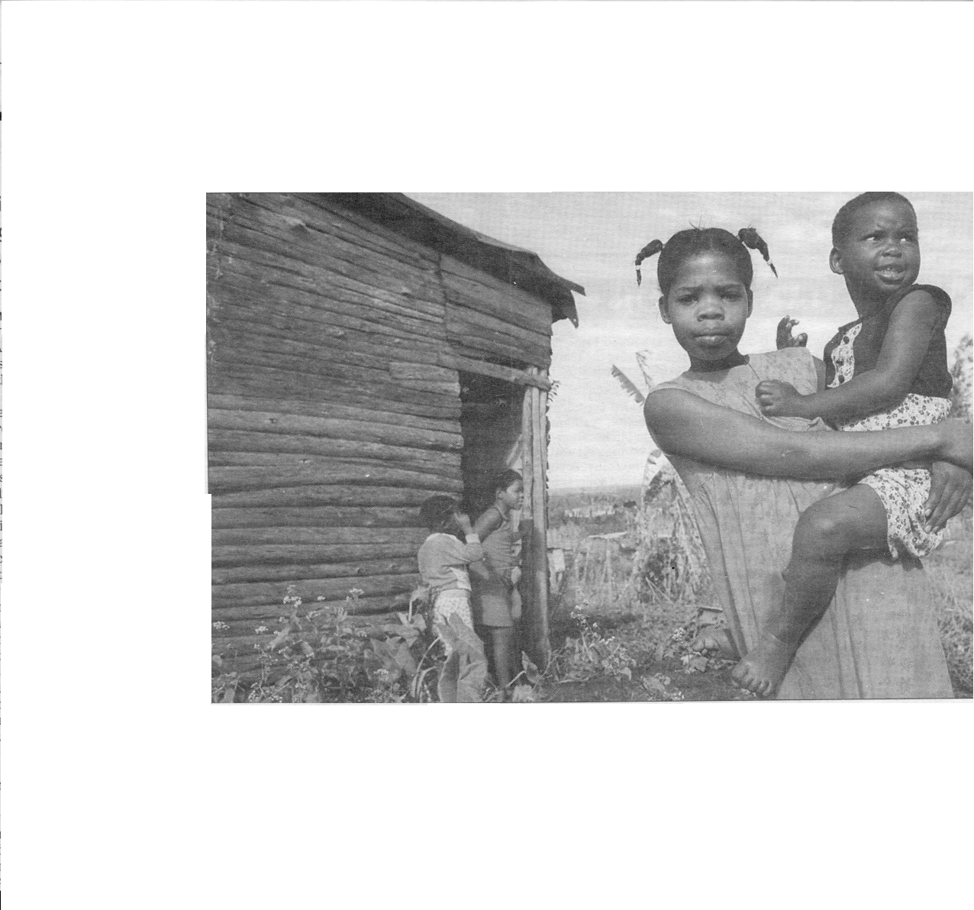
A Situation of Crisis - OVC’s
3.8million orphans in SA in 2010; 885,000 double orphans (Gen. HH Survey 2010)
28% increase in 2002
98,000 child headed households
Capacity constraints
Poverty & unemployment
Community capacity to “absorb” is saturated
Current scale of response is inadequate
Mail & Guardian, 13-19 October 2000

Slide 9
SNH National Overview
– Projects known to PPT only
Projects with approved subsidies:
Number of projects | 83
Capital value | 89 264 721
Number of beneficiaries | 3 922
Projects under preparation:
Number of projects | 25
Number of facilities | 61
Capital value (R.million) | 39 709 864
Number of beneficiaries | 770

Slide 10
SNH National Overview
– Projects known to PPT only
 | KZN | Gauteng | EC | WC | F/S
Projects with approved subsidies:
Number of projects | 43 | 21 | 18 | 0 | 1
Capital value | 62 688 970 | 6098152.6 | 18994098.84 | 0 | 1483500
Number of beneficiaries | 2 818 | 730 | 324 | 0 | 50
Projects under preparation:
Number of projects | 10 | 0 | 6 | 9 | 0
Capital value (Rmillion) | 9 808 276 | 0 | 9065620.13 | 20835968 | 0
Number of beneficiaries | 284 | 0 | 130 | 356 | 0

Slide 11
SNH National Policy Overview
Housing / shelter for those in special need enshrined in Constitution and Housing Act (‘…National, provincial and local spheres of government must…promote… the meeting of special housing needs, including but not limited to the needs of the disabled’
NDHS HIV AIDS Policy Framework of 2003 recognised the need : a) for the DHS to assist departments such as Social Development and Health with shelter and housing issues; b) for partnerships between public, civil sector and private sectors; c) to factor in the transitional subsidy scheme; d) for NDHS to develop guidelines to implement this.

Slide 12
SNH National Overview
Provincial policies in KZN (1999), E Cape, W Cape.
Provincial programmes in KZN, E Cape, Gauteng
National SNH Forum 2006-8 – culminating in submission and briefing document to NDHS calling for a national directive to enable and empower SNH rollout in new provinces and ring-fence subsidy funding for it
Yet currently no enabling SNH national directive to provinces (or unequivocal support)
Provinces like W Cape ‘uncertain’ – others taking no action

Slide 13
W Cape SNH Policy
“Policy to Support Group Accommodation for People with Special Needs’ was released in March 2009
Launched jointly by WC DHS, WC DH, WC DOSD
Memorandum already signed between these departments 2008
2010 WC DHS made contact with PPT to assist with implementation guidelines
Agreed to undertake pilot projects in parallel
Nine pilot projects identified and assessed by PPT for WCDHS (pro bono)
Nov 2010 draft implementation guidelines finalised
Concerns raised eligibility of subsidy mechanism
Decision to make MINMEC submission
Jan 2012 WCDHS indicated intention to terminate
Joint NGO submission in March 2012

Slide 14
W Cape Procedural Guidelines
NPO’s with viable potential projects can apply for PREPARATION FUNDING to NDHS, template for evaluating applications for preparation funding with criteria, application form proforma – must have prelim support WC DOSD / Health (typically between R40k and R250k)
Compile comprehensive feasibility including paying for consulting / support NGO services to assist them
NPO or Municipality applies for SNH subsidies with WC DOSD / Health support
Evaluated by DHS
If approved then Agreement signed and capital funding released to NPO / municipality to build

Slide 15
SNH Project Preparation - Feasibility
Need
DSD / DH letter of support
Institutional capacity of NPO
Operating funding
Operational plan & sustainability
Land / legal issues
Capital costs – acquisition / refurbishment / renovation
Capital co-funding (if any)
Technical studies for site suitability e.g. geotechnical study, basic enviro. assessment, contours, infrastructure (bulk and internal)
Technical studies for prelim. design e.g. site & building plans, foundation design,/ structural engineering report, costing, construction estimates, quality control, etc.

Slide 16
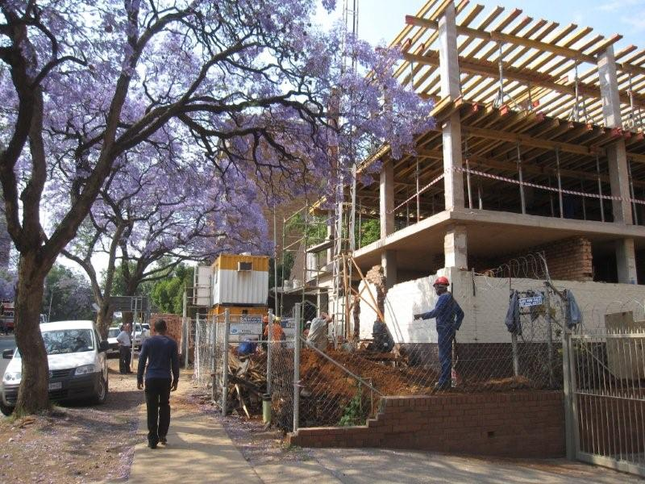
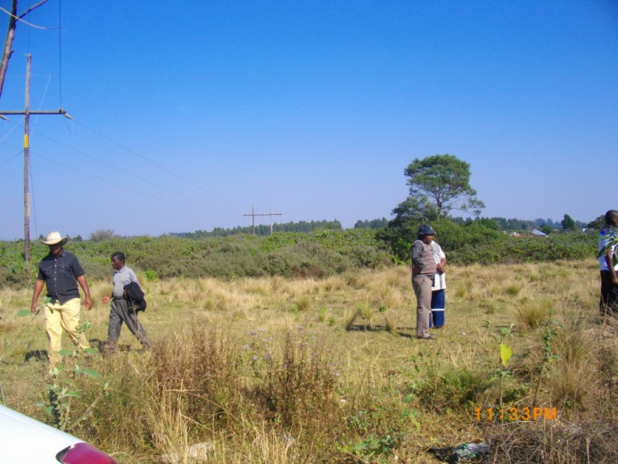
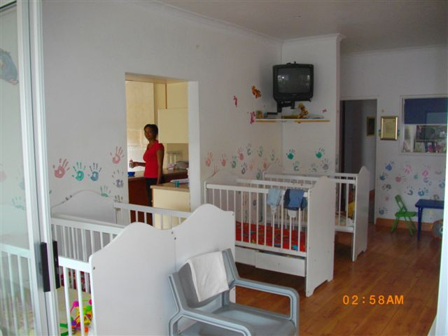
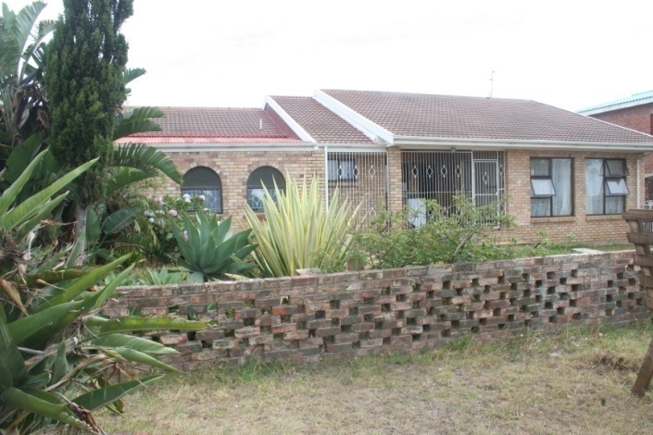
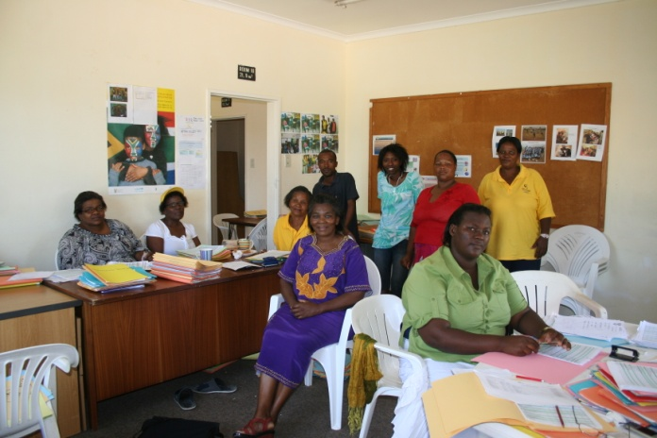
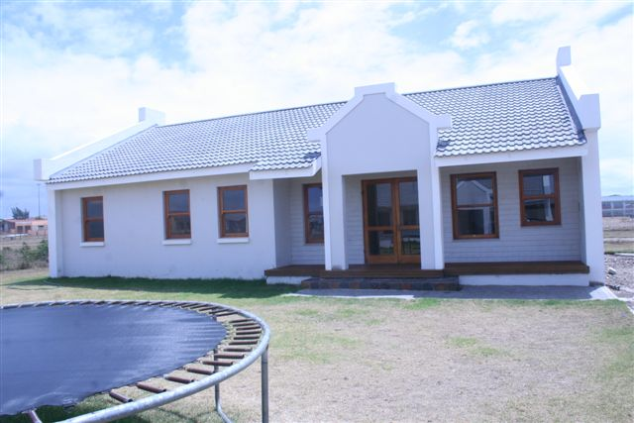

Slide 17
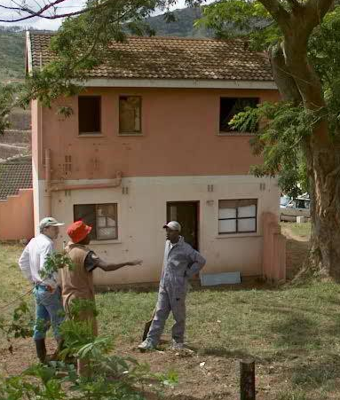
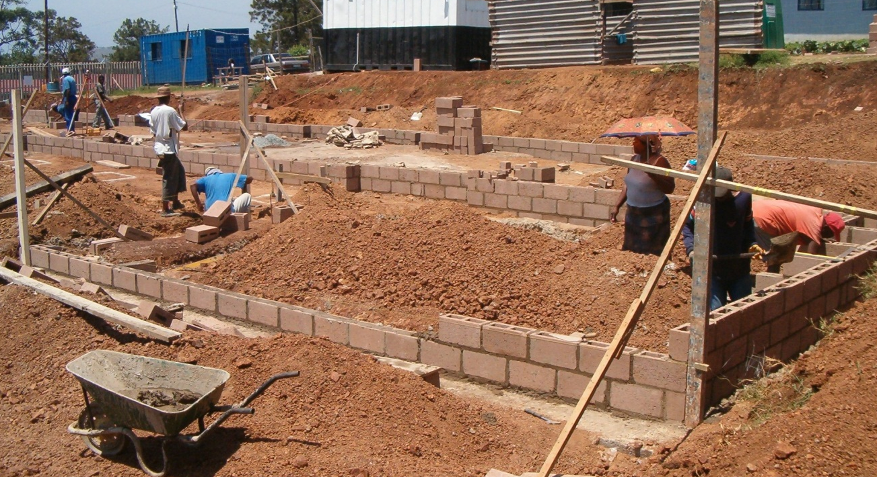
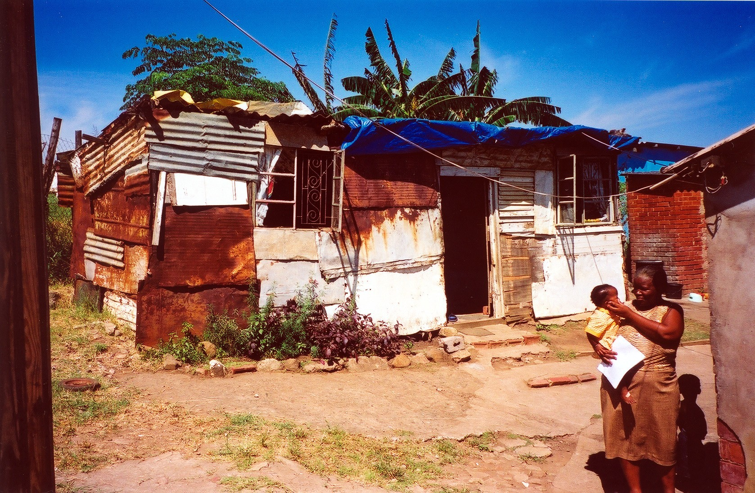
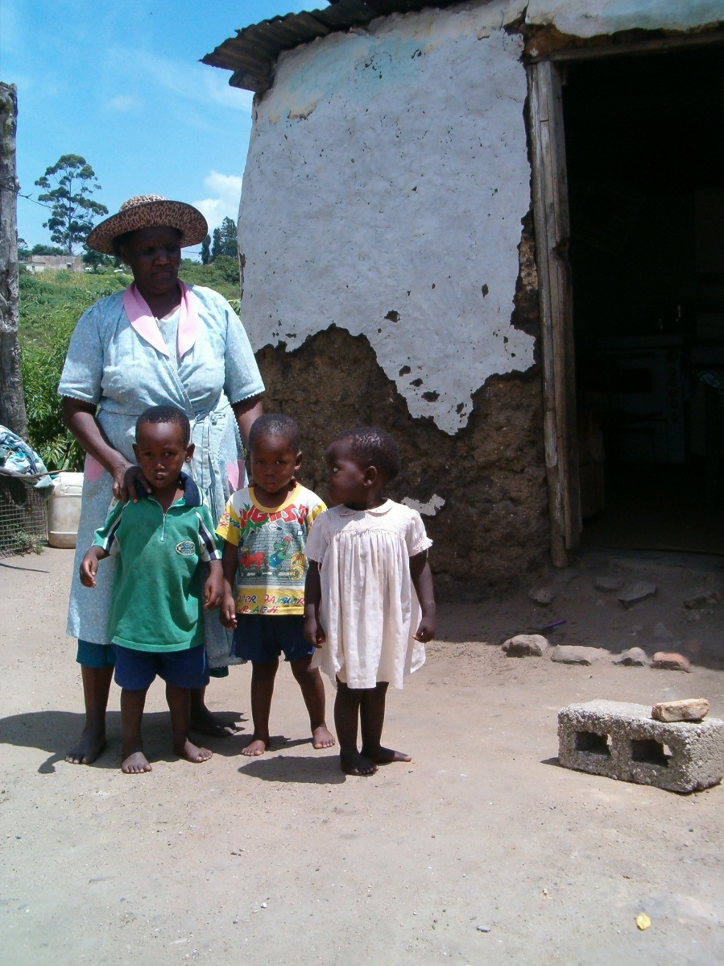

Slide 18
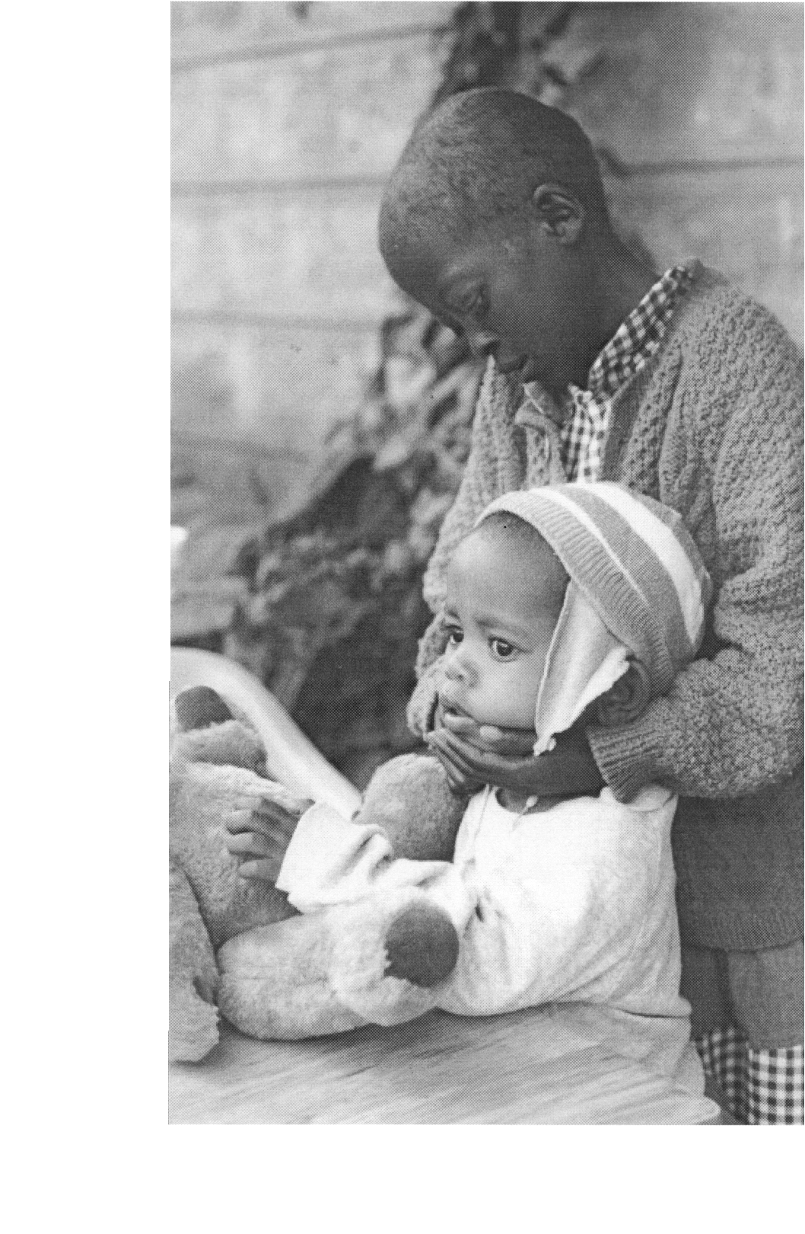
Main Challenges
Poor understanding of SNH (e.g. confusion with social housing)
Lack of enabling national policy directive – no implementation of 2003 intentions
W Cape Policy on hold
Lack of preparation funding for NPO’s to develop viable projects and demonstrate feasibility
Variable co-operation between different provincial departments (e.g. w.r.t project approvals)
Operational funding for NPO’s

Slide 19
Main lessons
There is a massive need for SNH
SNH is viable and ‘do-able’
High cost-benefit ratio
Small budgetary demand
Significant project pipeline already in place
Several well established provincial SNH policies and programmes
Partnership government and NPO’s critical –leverage NPO capacity to champion SNH
Preparation and preparation funding is critical to success
Unequivocal NDHS support is important
Improved co-operation between different departments is necessary
Pilot projects play a key role in ‘new’ SNH provinces (low risk environment, test policy in practice)

Slide 20

Thank you
Project Preparation Trust of KZN
(031) 305 1288
info@pptrust.co.za
www.pptrust.co.za

Slide 21
NPO identifies need and
project concept
NPO confirms support from DSD/ Dept Health
Prelim assessment (PPT)
Allocation of Preparation Funding Budget (PPT)
Project evaluation (DHS)
Project Approval (DHS)
Agreement between DHS and NPO
Feasibility Study (Land availability , ownership, layout, GP , availability of services, Geotech, contours, house and foundation design, costing, management, quality control) and operational plan and sustainability
Business Plan/ Housing Subsidy application
Flow Char t

Slide 22
Operation and Maintenance
SNH Beneficiaries occupy house(s)
DHS arranges 1 st Coordination meeting
Official opening by MEC
Project Sign off / Closure (DHS)
Stage drawdowns signed off by relevant officials (DHS)
Technical Inspections and Quality Assurance (DHS)
Appoint Builder Registered with NHBRC
(NPO/ Municipality) Construction commences
Land acquisition and transfer
(1st drawdown) (NPO/ Municipality)
NPO appoints Project Manager (if required)
Flow Char t
NPO recruits House parents / carers
NPO identifies beneficiaries from their list
NPO sets statutory processes in motion where applicable / enrolment of beneficiaries

Slide 23
Project and programme work
PROJECT PREPARATION FUND
Preparation funds
Required by NPOs to attend to feasibility / subsidy application
Not provided in KZN / EC
Provided by PPT interest free
Recovered from NPO from subsidy amount once project is approved
Replenish Preparation Fund
Assist another NPO
NPO applies for assistance
Pre- screening
Feasibility (incl. professional services)
Project Approved
NPO re-pays PPT
Project preparation/ funding Agreement
PPT issues invoice to NPO
Replenish Preparation Fund

